Slide 1

Compiler Design Assignment 2
Iran University of Science & Technology
School of Computer Engineering
Spring 2021

Slide 2
Assignment Specifications
Subject: Introduction to Listener
Deadline: Monday, 25 Esfand, 23:59 (Would not be extended!!)
Where to upload: LMS
Your report should be provided continuing these slides
Full Name: keyvan dadashzadeh
Student ID: 97522148

Slide 3
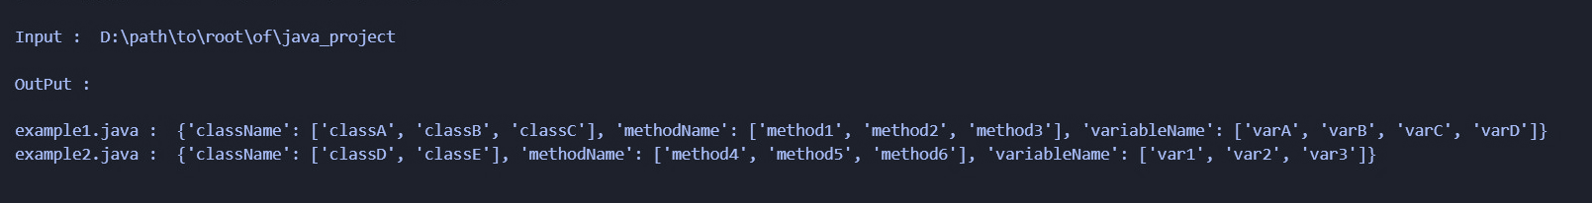
Assignment Details
Write a Python program using Listener to extract these from a Java project:
The names of all classes exist in each Java file.
The names of all methods exist in each Java file.
The names of all variables exist in each Java file
As sth like below:
Note: The output format can be different depends on your Java project. You might have different number of java files, classes, methods & variables.

Slide 4
Assignment Details (Continued)
2. Write a report of what you did .Test some examples on & use images to make your report more clear.
Good Luck!

Slide 5
Generate file with antlr
First we create required files with antlr command:
antlr4 -Dlanguage=Python3 -listener JavaLexer.g4 -o gram
antlr4 -Dlanguage=Python3 -listener JavaParserLabeled.g4 -o gram

Slide 6
Some util’s
After previous section now it’s time to jump into code
First we write simple function to return list of java files in directory:\
def listFiles(path):
onlyfiles = [f for f in listdir(mypath) if isfile(join(mypath, f))]
onlyJavaFiles = [x for x in onlyfiles if "java" in str(x)]
return onlyJavaFiles

Slide 7
Some util’s
After that we write simple function to run listener on given file:
def run_listener_for_given_file(full_file_path):
lexer = JavaLexer(FileStream(fileName=full_file_path))
stream = CommonTokenStream(lexer=lexer)
parser = JavaParserLabeled(input=stream)
tree = parser.compilationUnit()
listener = Listener(file=file)
walker = ParseTreeWalker()
walker.walk(listener=listener, t=tree)
return listener

Slide 8
Write proper listener (class)
First we are going to find class first we override function enterClassDeclaration then we will add found class’s to class list’s:
def enterClassDeclaration(self, ctx: JavaParserLabeled.ClassDeclarationContext):
self._list_of_classes.append(str(ctx.IDENTIFIER()))

Slide 9
Find methods
After done previous section this section is same. Just we need override function enterMethodDeclaration then add found method to list of methods:
def enterMethodDeclaration(self, ctx: JavaParserLabeled.MethodDeclarationContext):
self._list_of_methods.append(str(ctx.IDENTIFIER()))

Slide 10
Find variable’s
In part is confusing because we can have 2 variables first variables are variables that exist inside class scope and second variables are variables that exist inside each function scope we assume our home work expect us to find both variables to list all of these variables we can simple override enterVariableDeclaratorId method then add identifier to list and print:
def enterVariableDeclaratorId(self, ctx: JavaParserLabeled.VariableDeclaratorIdContext):
self._list_of_variables.append(str(ctx.IDENTIFIER()))

Slide 11
Find variables
But may you want to find just class scope variable’s to achieve this we simple can add flag to listener class then then every time we enter enterFieldDeclaration we simply can notify listener that we entered inside class scoped variables then in enterVariableDeclaratorId we can simple get variable (Note: because I assumed that question dont want find this kinda variables I dont put code of this problem)

Slide 12
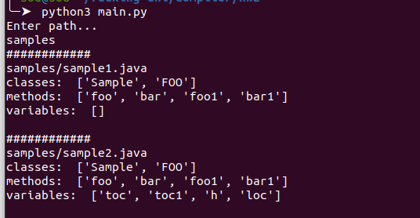
Thank you
All code available inside in this report directory.
And one image available to show how to run code’s:

